Slide 1

Trading Master using Python
Project Presentation
By
MITU19BTCS0104 Hardik Gupta
MITU19BTCS0038 Vedant
MITU19BTCS0171 Piyush Marathe
MITU19BTCS0185 Shardul
Guided By
Prof. Avinash Ingle
Department of Computer Science & Engineering, MITSoE, Loni Kalbhor

Slide 2
Outline
1 INTRODUCTION
2 CONCEPTS AND METHODS
3 LITERATURE SURVEY
4 PROJECT PLAN
5. SOFTWARE REQUIREMENT SPECIFICATION
6 RESULTS
7 SOFTWARE TESTING
8 CONCLUSION AND FUTURE WORK
BIBLIOGRAPHY
ANNEXURE A: List of Publications and Research Paper (In its Original formats)
ANNEXURE B: Plagiarism Report
Department of Computer Science & Engineering, MITSoE, Loni Kalbhor

Slide 3
1. Introduction
We undertook this project to illustrate the significance of Technology and Data Science in the currency market and how we can take leverage it. In the past decade, we have witnessed an unprecedented rise of Cryptocurrency in the currency market.
Cryptocurrency is backed by Blockchain Technology and has been recognized as one of the most efficient and safest way of making transactions.
In this project we have utilized Machine Learning Algorithms and Time-Series for analysis and predictions using Python Programming Language.
Department of Computer Science & Engineering, MITSoE, Loni Kalbhor

Slide 4
2. Problem Statement
Time Series Data is the type of historical data, which resembles the group or observation of the data that have been collected over time according to the continuous period of time. It comprises of numerous method to study and analyze the data. And Further it can be help us to derive the trend of data set.
It basically represents the value of a particular variable at different point of time.
The Time Series Data generally consists of the following components: Level, Noise, Trend and Seasonality.
Department of Computer Science & Engineering, MITSoE, Loni Kalbhor

Slide 5
3. Objectives
In this project, our main objective is to analyze the cryptocurrency data using different algorithms and to use that data to get meaningful insights about the cryptocurrencies. We will then use the results to find the most suitable cryptocurrencies for trading that can yield high profits to the traders in the future.
The analysis of cryptocurrencies consists of two main parts:
Fundamental Analysis : which involves analyzing a cryptocurrency’s future on the basis of its current financial performance. In this, we take the intrinsic value of the asset(s) and try to assess all the important financial related aspects be it earnings, expenses, assets, liabilities, etc. Also in this we study on the overall market and industry conditions.
Technical Analysis : which involves visualizing the cryptocurrency data using various graphs and charts to identify the trends in it. In this basically we analyze the market indicators of the asset, such as market resistance, support, trend lines, momentum-based indicators etc. It helps us to develop charts and patterns of the cryptocurrency.
Department of Computer Science & Engineering, MITSoE, Loni Kalbhor

Slide 6
4. Concepts and Methods
CoinMarketCap: It is the largest cryptocurrency trading platform. We have utilized this platform for supplying the current market price(CMP) of the selected cryptocurrency as well as price over a certain period of time.
Binance: This platform provides us with the documentation and backend support for our UI. And also we have utilized this platform for extracting the dataset of the selected currency.
Long Short Term Memory Model(LSTM): LSTM, also known as Long Short-Term Memory network, is the most commonly used Recurrent Neural Network for the analysis of time-series data. A simple RNN works fine with short-term dependencies. But while working with time series data, we require a neural network that is capable of dealing with long series of data. A LSTM network solves this problem by providing a long-term memory
Department of Computer Science & Engineering, MITSoE, Loni Kalbhor

Slide 7
5. Literature Survey
A Comparison of ARIMA and LSTM in Forecasting Time Series – With the rapid advancement on developing refined AI based strategies and specifically deep learning algorithms, these procedures are gaining popularity among scientists in the domain. The significant question is then how precise and powerfully these recently discovered methodologies are when compared with the conventional strategies.
The paper compares the accuracy of ARIMA and LSTM, as representative systems when predicting time series data. LSTM-based models outperform ARIMA-based models with a high margin. These two methodologies were executed and applied on a set of ﬁnancial data and the outcomes showed that LSTM was superior to ARIMA.
Furthermore, the LSTM-based algorithm improved the prediction by 85% on average compared to the ARIMA-based algorithm. The work depicted in this paper advocates the beneﬁts of applying deep-learning based algorithms and methods to the financial aspects and ﬁnancial information.
Department of Computer Science & Engineering, MITSoE, Loni Kalbhor

Slide 8
6. Tools and Languages
PyCharm
CoinMarketCap
Binance
Long Short Term Memory Model (LSTM)
Time Series Analysis
Department of Computer Science & Engineering, MITSoE, Loni Kalbhor

Slide 9
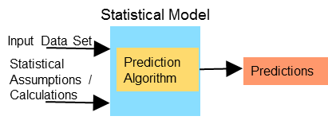
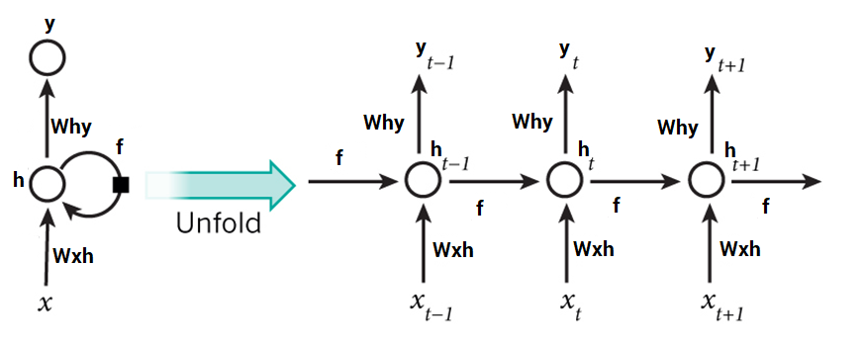
7. Process and Architecture
Statistical Model
LSTM Model
Department of Computer Science & Engineering, MITSoE, Loni Kalbhor

Slide 10
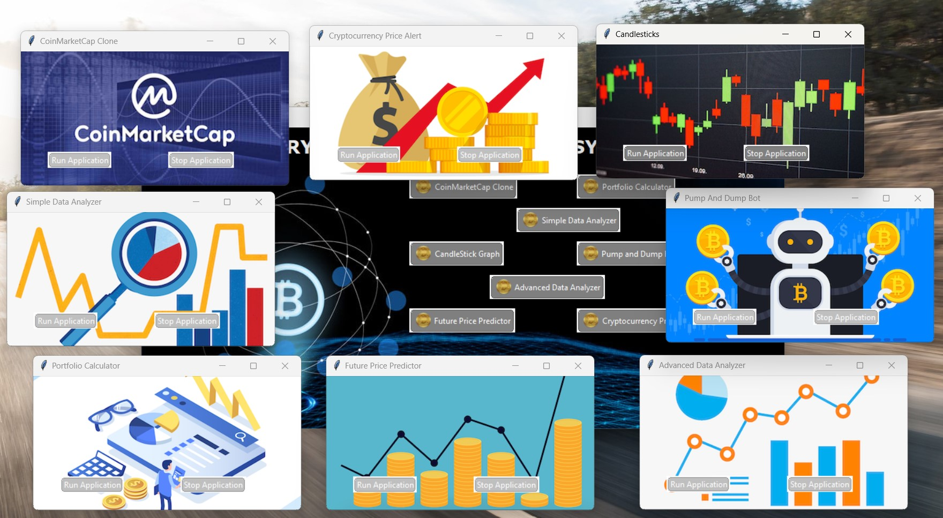
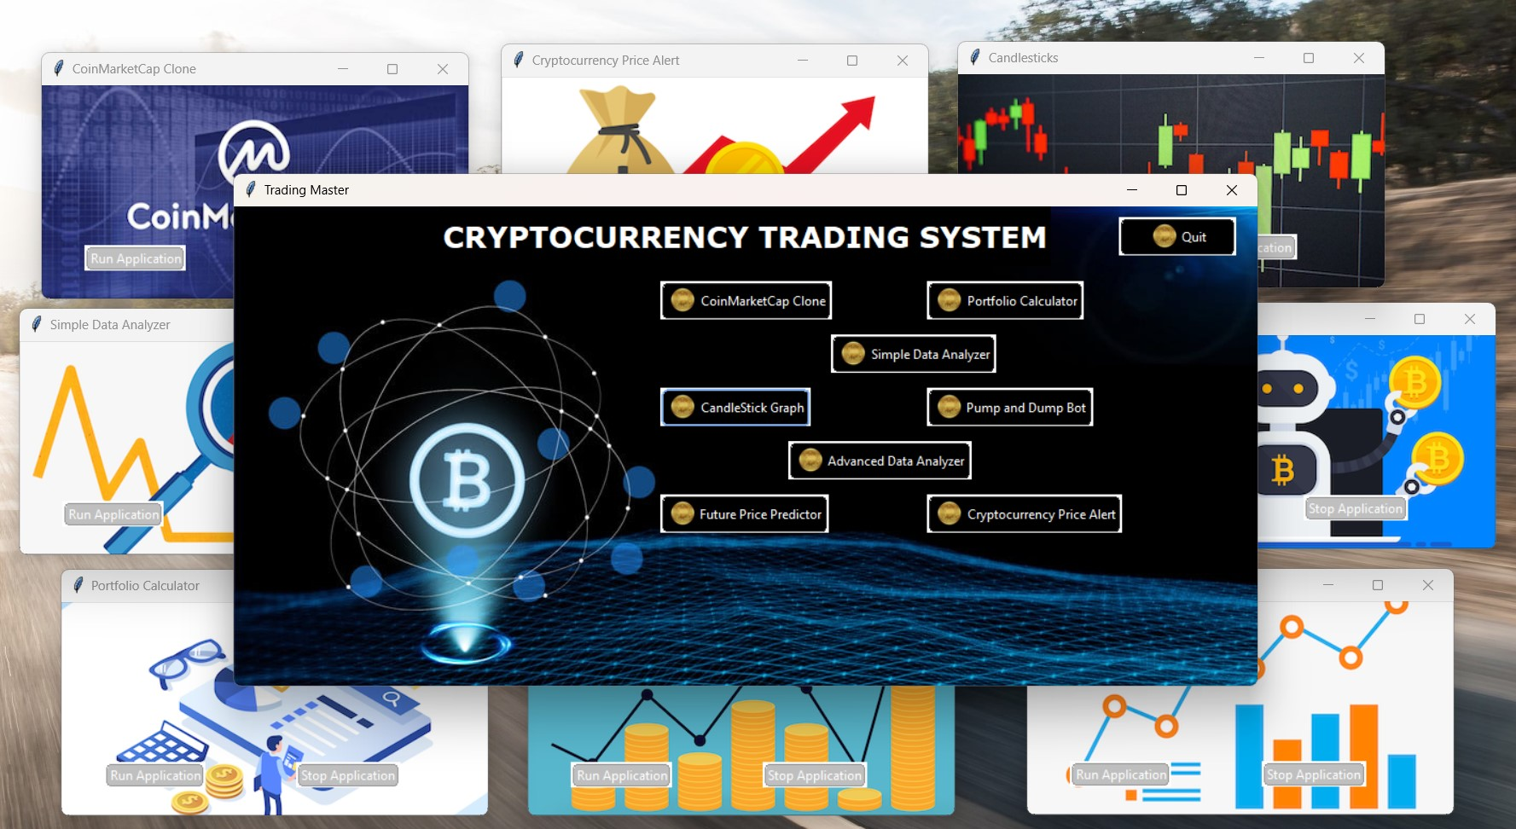
8. Implementation
User Interface
Department of Computer Science & Engineering, MITSoE, Loni Kalbhor

Slide 11
8. Implementation
1. CoinMarketCap Application
This application allows an investor to view this data with ease.
It uses the listings API to get the latest data from the website.
To make the data more understandable, the data is filtered based on the several conditions and the data of the top 100 cryptocurrencies is only displayed to the user at a time.
2. Portfolio Calculator
This application tells the current value of the cryptocurrency in our portfolio in US Dollars
The Current value of the entire portfolio will also be displayed to help the investor in keeping a track of his investments.
Department of Computer Science & Engineering, MITSoE, Loni Kalbhor

Slide 12
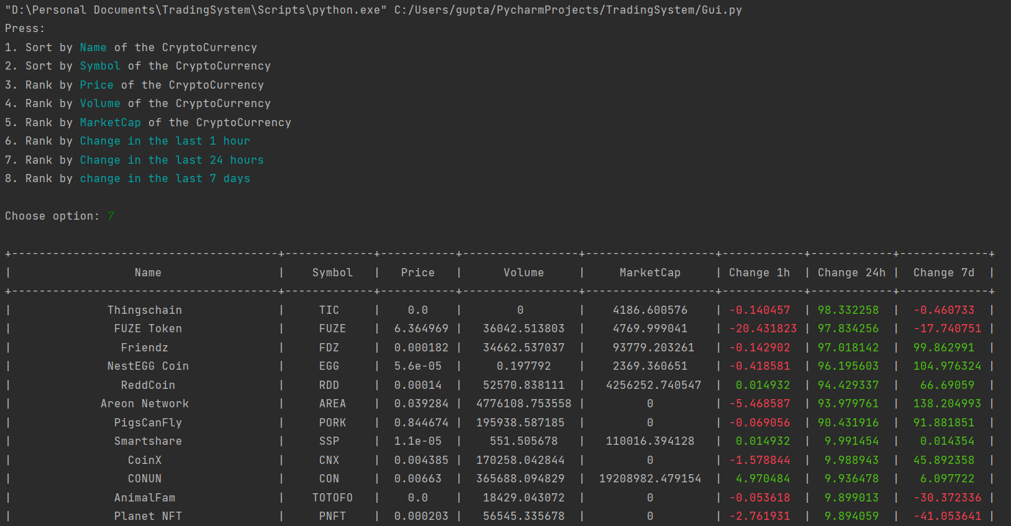
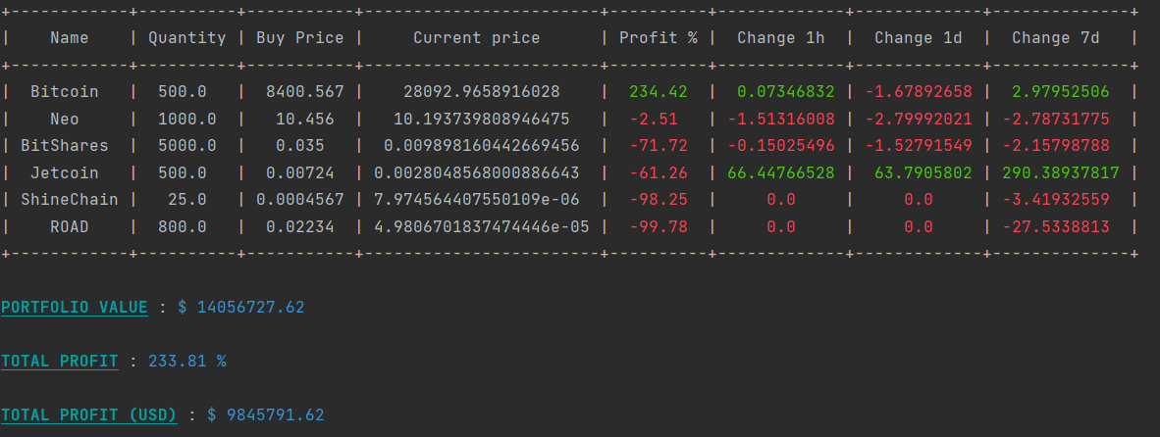
9. Results
Department of Computer Science & Engineering, MITSoE, Loni Kalbhor

Slide 13
8. Implementation
3. Price Alert Application
This application alerts the investor about any change in the prices of cryptocurrencies.
This application can also run in background allowing the user to get continues price alerts and will make a Beep(Alert) sound whenever the prices fluctuate or cross limits.
4. Simple Data Analyzer
It is a statistical application that helps the investor to understand the cryptocurrencies better, the trends of change between them so that he/she can make appropriate calculations before investing their money in these digital currencies.
The data in this application is sorted and displayed at every iteration in the output of application.
Department of Computer Science & Engineering, MITSoE, Loni Kalbhor

Slide 14
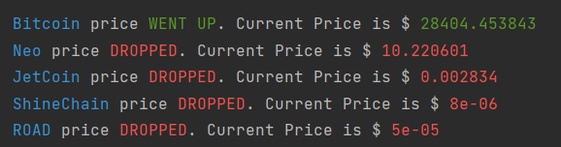
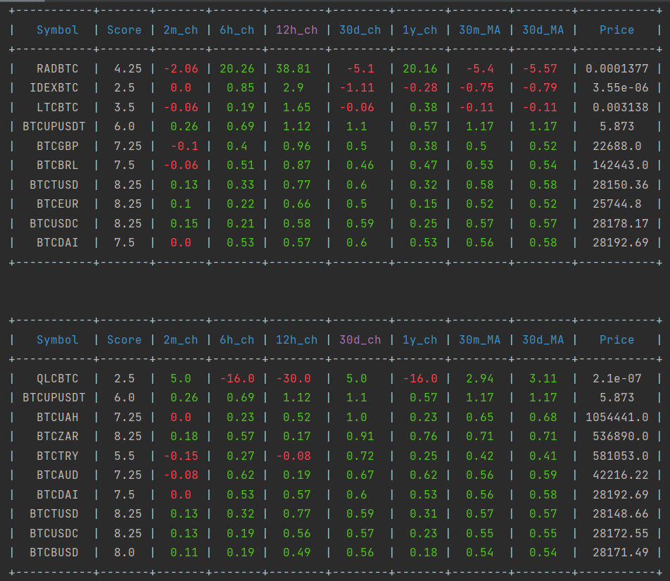
9. Results
Department of Computer Science & Engineering, MITSoE, Loni Kalbhor

Slide 15
8. Implementation
5. Advanced Data Analyzer
It starts to analyze the data of these cryptocurrencies and calculates a number of parameters that are essential to monitor the performance of the cryptocurrency.
The analyzer also runs a ranking algorithm which assigns a score to each and every cryptocurrency.
6. Predictor and Price Forecasting Application
The data fetched using the API is put to train a Neural Network model using LSTM layers.
When the price forecasting application runs, firstly it extracts the historical data of the selected cryptocurrency and then it tries to predict the future value of the cryptocurrency.
It informs the user whether the selected cryptocurrency will return profit or loss in the future.
Department of Computer Science & Engineering, MITSoE, Loni Kalbhor

Slide 16
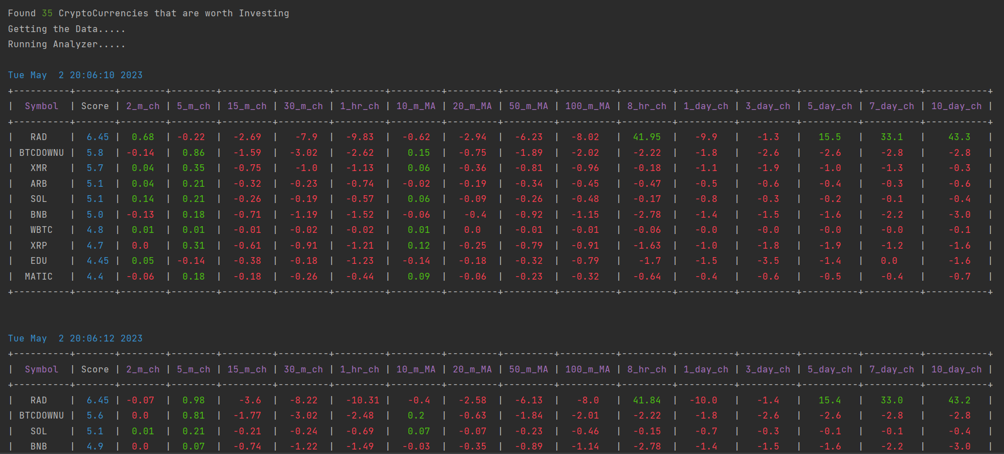
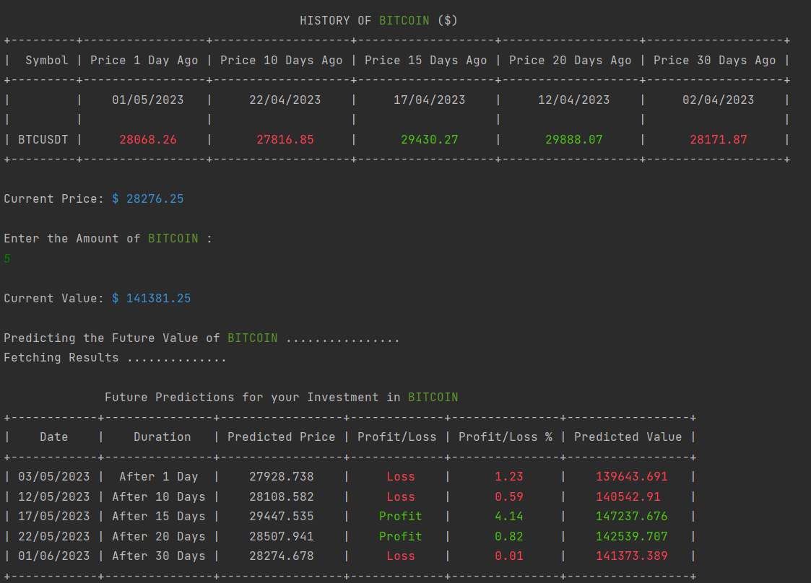
9. Results
Department of Computer Science & Engineering, MITSoE, Loni Kalbhor

Slide 17
8. Implementation
7. Candlestick(s) Application
This application is used to put the data in graphical representation.
The user can select any cryptocurrency and visualize the performance of the particular cryptocurrency over the past years.
A single candlestick graph provides a lot of information to the user such as the daily open, close, high and low price of the cryptocurrency.
8. Pump and Dump Trading Bot
It is an automatic buying and selling bot that reduces the efforts of investors and trades the digital currency automatically as per the instructions.
Trading bot is a useful application for doing automated buying and selling operations as manually buying and selling at a very particular moment of time is a tedious task and requires a lot of accuracy.
Department of Computer Science & Engineering, MITSoE, Loni Kalbhor

Slide 18
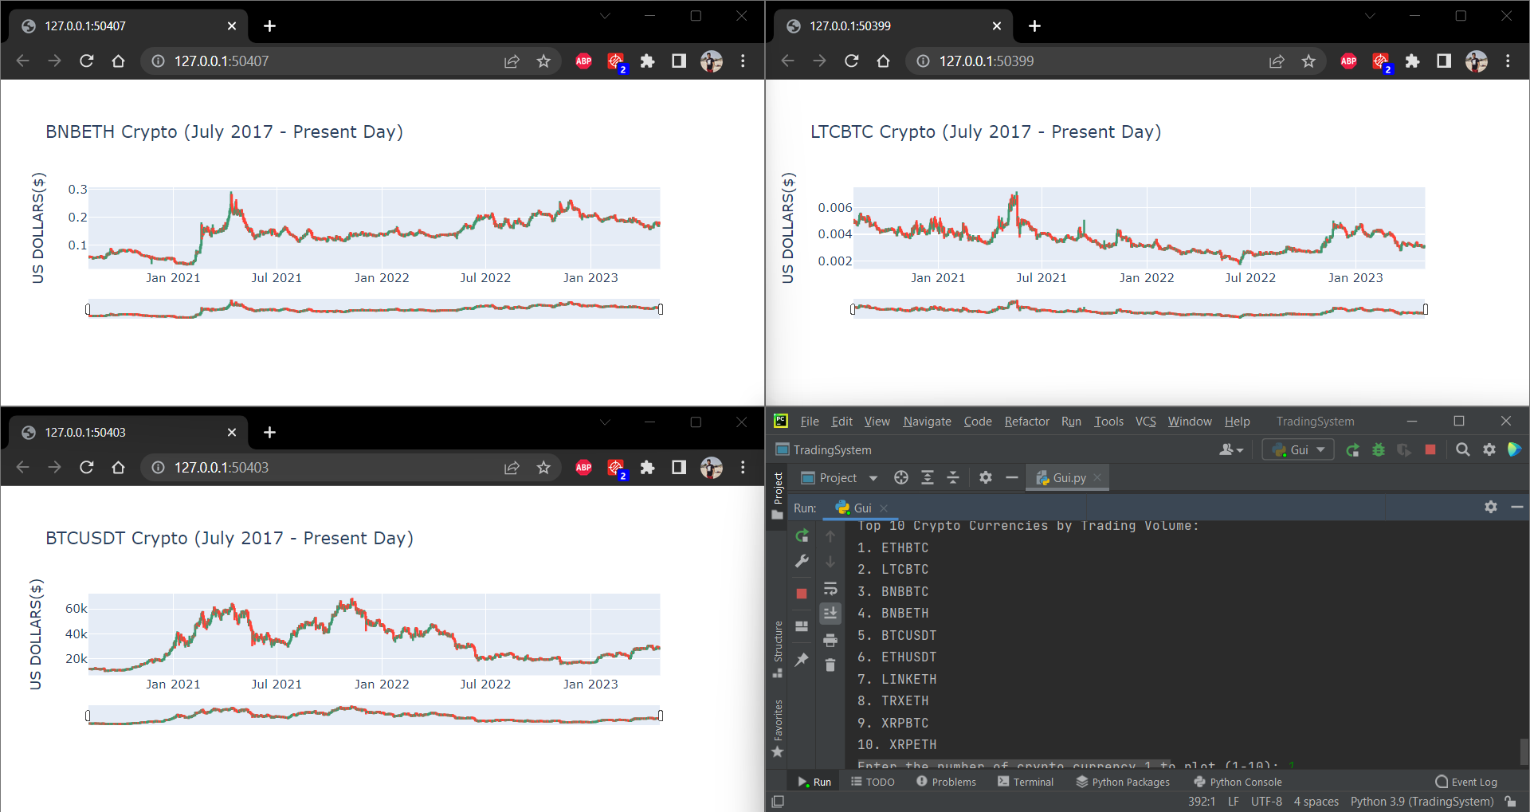
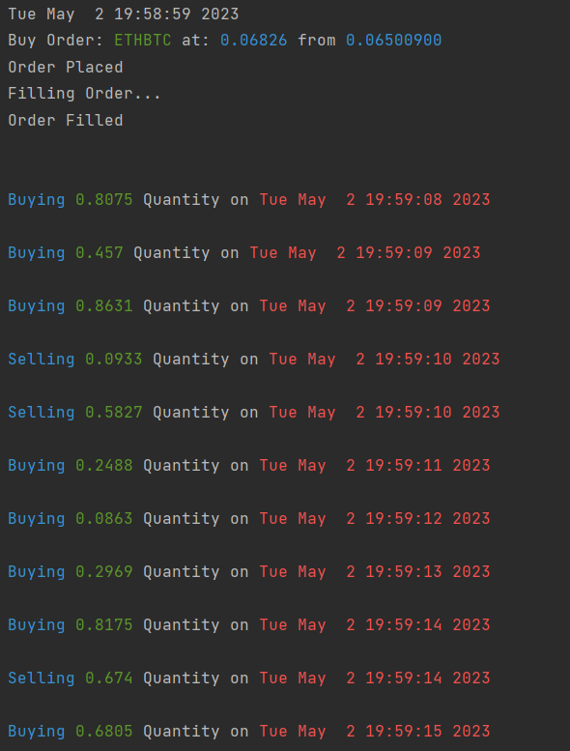
9. Results
Department of Computer Science & Engineering, MITSoE, Loni Kalbhor

Slide 19
10. Conclusion and Future Work
In this project, we have made an API to collect the dataset of the user selected cryptocurrency on real- time basis from two online trading platforms, namely Binance and CoinMarketCap, post data collection, we employ the data in LSTM and this model helps us to analyze the dataset and find out the trend of the particular cryptocurrency. This analysis is done on the basis of numerous factors in term of volume traded in the last 24 hours, 52-weeks high, 52-weeks low, plunging patterns and other fundamental aspects.
Also, in the CoinMarketCap API we have provided the user with the option to show the list of cryptocurrency on the basis of factors such as Name, Symbol, Price, Volume, Market Cap and Change in Price. It helps user to get meaningful insights. Further, in the project, there is an advance data analyzer which employ the period change and moving average techniques to analyze the data.
Department of Computer Science & Engineering, MITSoE, Loni Kalbhor

Slide 20
10. Conclusion and Future Work
Multi-User Application
The current version of the trading system can support only a single user. Perhaps in the update the trading system can be extended to support multiple users at the same time. Using paid and more advance APIs instead of the basic APIs, we can easily extend the support of this application to numerous users.
Deploying the Model on Cloud
The predictive model can be trained and deployed on a cloud platform. Deploying the model on cloud does not remove the geographical barrier for our trading system but it will also increase the computation power and hence can give faster and more accurate results.
Mobile App for Trading System
At present, this trading system is compatible only with desktop versions of Windows and Mac operating system. But in the next update we can integrate our API and Application in the mobile versions with some modifications in the basic structure and User Interface, a mobile app can be developed for Android and IOS mobile users.
Department of Computer Science & Engineering, MITSoE, Loni Kalbhor

Slide 21
11. List of Publications
Department of Computer Science & Engineering, MITSoE, Loni Kalbhor

Slide 22
References
[1] The Future of Time Series – Neil A. and Andreas S. Weigend http://citeseerx.ist.psu.edu/viewdoc/download?doi=10.1.1.84.5754&rep=rep1&type=pdf
[2] Big data and time series: A literature review paper https://www.researchgate.net/publication/324491094_Big_data_and_time_series_A_literature_review_paper
[3] An Analysis of Cryptocurrency, Bitcoin, and the Future – Peter D. DeVries https://www.researchgate.net/publication/316656878_An_Analysis_of_Cryptocurrency_Bitcoin_and_the_Future
[4] https://www.crowdfundinsider.com/wp-content/uploads/2017/04/Global-Cryptocurrency-Benchmarking-Study.pdf
[5] https://decryptionary.com/what-is-cryptocurrency/introduction-to-cryptocurrency/
[6] https://www.fool.com/investing/2017/12/19/16-cryptocurrency-facts-you-should-know.aspx
Department of Computer Science & Engineering, MITSoE, Loni Kalbhor

Slide 23
Thank You
Department of Computer Science & Engineering, MITSoE, Loni Kalbhor

Slide 24
Questions
Department of Computer Science & Engineering, MITSoE, Loni Kalbhor

